Slide 1
Dance Dance Revolution by Dhea Mariesta Start

Slide 2
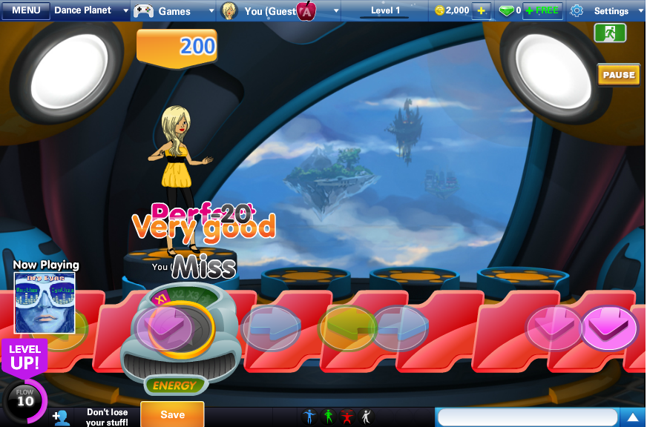
Remember this?

Slide 3
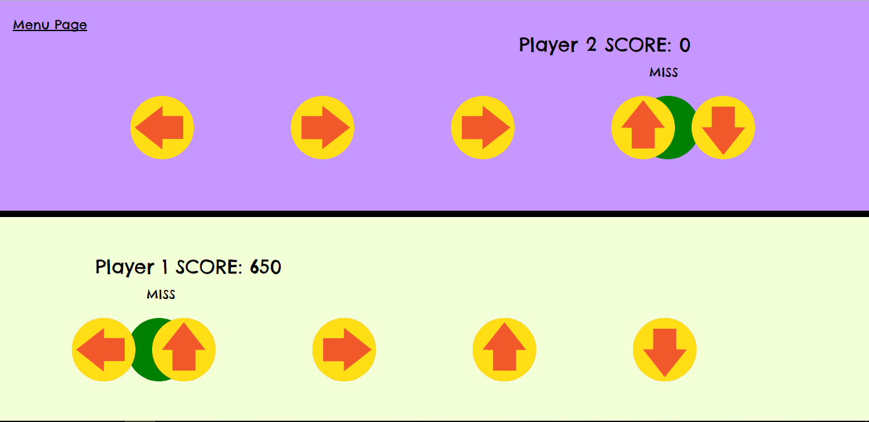
The result

Slide 4
Process
The basic functionalities
Juice
Some other features

Slide 5

Basic functionalities
game
Create the necessary objects
Game, ball, target
Collision detection
Game over when song ended
Scoring system
ball
target

Slide 6
Initially both target and ball are under the same object.
Initialized the target everytime the ball is generated
Face problem in detecting the score since I have to delete the passing ball which means delete the target in that object at the same time
Decided to make the two of them separate object so that no need to generate new target everytime
One target to listen to every time the keyboard is hit when ball reach its position

Slide 7



Juice
Sound effect
Collision detection
Mouse hover and mouse click
Ding!
click
Start
Start

Slide 8
Juice
Comments
Excellent, good, bad
Different score based on performance
excellent
good
bad
none

Slide 9
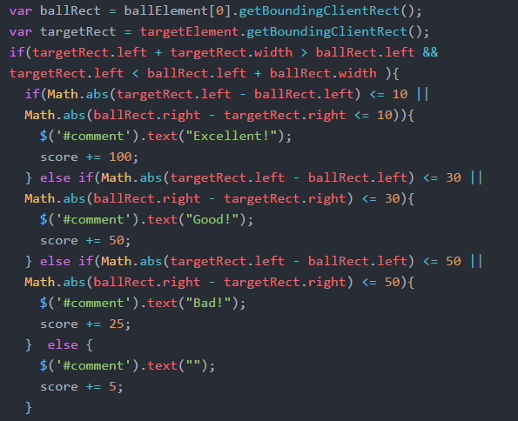
ballRect
targetRect

Slide 10
Two players
Initial idea: create two initial points to generate ball and target under the same object
Fail hahahaha. Objects don’t know need to listen to what and which one

Slide 11
Overall features
Font: Chelsea Market (https://fonts.google.com/specimen/Chelsea+Market)
Music:
Menu page: Maple leaf rag
Game: The entertainer

